Slide 1




Welcome to
Palfrey Infant School
Happy Children Aiming High

Slide 2


March 2025
This months value is Equality
Each year group will be looking at:
We are all important
When we grow up, hopes, dreams and aspirations

Slide 3



Good Work Assemblies
Our weekly Good Work Assemblies are every Friday. We celebrate achievements and award children for good learning and bucket filling. (kindness).
We talk about good attendance in school and award children with more than 96% attendance weekly. The winning class get 2 stickers and if the class gets 100% the get 3 stickers. This hopefully promotes teamwork to come to school whenever possible.
The class with the most stickers at the end of the term win a box of chocolates!

Slide 4


World Book Day – 7th March 2025
The Hungry Caterpillar
This year our school Book Day Theme is:
The Hungry Caterpillar. All our staff and children are dressing up as their favourite caterpillar or as a favourite character.

Slide 5

World Book Day Special Lunch Friday 7th March 2025
The kitchen are putting on a special lunch to celebrate World Book Day
The children are looking forward to it!

Slide 6


We are a NUT FREE School
Palfrey Infant School is a NUT FREE school.
We aim to protect children who have allergies to nuts yet also help them, as they grow up, to take responsibility as to what foods they can eat and to be aware of where they may be put at risk.
Please refrain from bringing in any types of NUTS as some of our children and staff have NUT allergies.
If you have any issues please speak to our office staff.

Slide 7


Red Nose Day 21st March 2023
Red Nose Day is here again to raise money through the power of laughter. It feels like we all need a laugh right now, and this Red Nose Day is all about coming together, spreading joy, and having the best day ever in school.
Red Noses can now be purchased through Amazon for £2.50.
Children and staff are to dress up and donate £1.00 for this wonderful cause.
Thank You for being
AMAZING

Slide 8



Ramadan 2025
This year, Ramadan is expected to begin at sundown on Friday 28th February and end at sundown on Saturday 29th March. The final evening of Ramadan consists of a celebration called Eid al-Fitr, when the traditional month-long fast is ended with a feast.
The exact beginning and ending times of Ramadan are based on the sighting of the Moon. Specifically, Ramadan is said to begin at the first observance of the new Moon over Mecca, Saudi Arabia (or on a date pre-determined by astronomical calculation). Because of this, start and end dates are not set in stone and may vary by a day.

Slide 9


EID Al-FITR LUNCH Tuesday 1st April 2025
To celebrate EID 2025, Staff and Children can dress in their party clothes and the kitchen are putting on special lunch to celebrate.

Slide 10
Key Dates
28th February – Ramadan Starts
5th March – Wellbeing Launch Day
7th March – World Book Day and Special Lunch
21st March – Red Nose Day
30th March – Mothers Day
31st March – School Closed for EID
1st April – Special Eid Lunch and Dress up Day

Slide 11
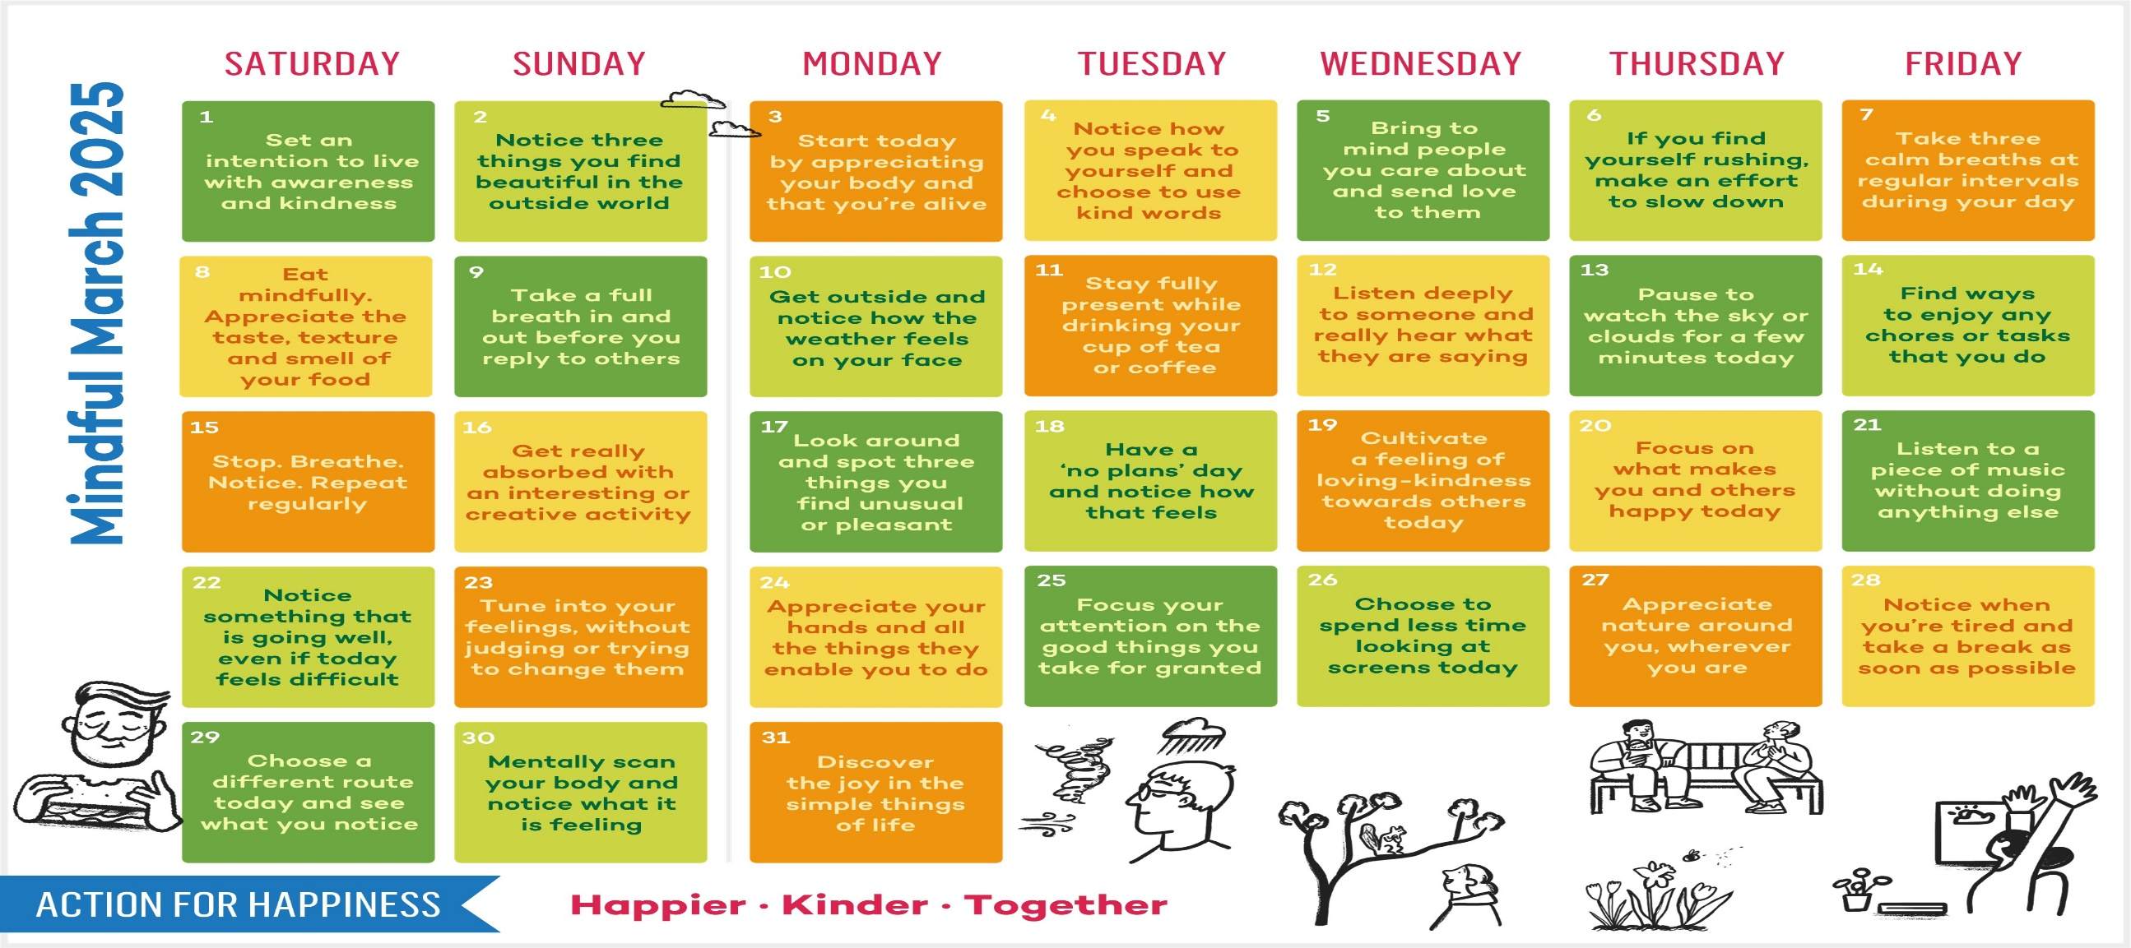
March 2025
The name March is ultimately derived from the Latin word Martius (named after Mars, the Roman god of war).

