Slide 1



Welcome to
Palfrey Infant School
Happy Children Aiming High

Slide 2
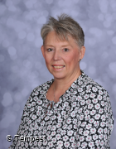


A message from Mrs Walsh
As we near the summer holidays, it is very important that the children continue to read over the summer holiday to allow them to continue to progress their skills. Walsall libraries will be hosting a summer reading challenge, details to be released shortly.
Reception had a fantastic time at Ash end farm and well done to Year 2 at the Walsall school games. We look forward to the upcoming sports day. Lastly, Year 2 have enjoyed their Ace groups at lunchtime where they have had the opportunity to take part in new exciting activities such as gardening, drama, art and play inboard games!

Slide 3





This months value is:
Reflection
Each year group will be looking at:
What values have we learnt
Review and Reflect

Slide 4






Book Fair
Thank you to all those who attended the bookfair. We are pleased to announce we have raised £412.00! The money raised will be used to buy new books for our school library!

Slide 5




Good Work Assemblies
Our weekly Good Work Assemblies are every Friday. We celebrate achievements and award children for good learning and bucket filling. (kindness).
We talk about good attendance in school and award children with more than 96% attendance weekly. The winning class get 2 stickers and if the class gets 100% the get 3 stickers. This hopefully promotes teamwork to come to school whenever possible.
The class with the most stickers at the end of the term win a box of chocolates!

Slide 6
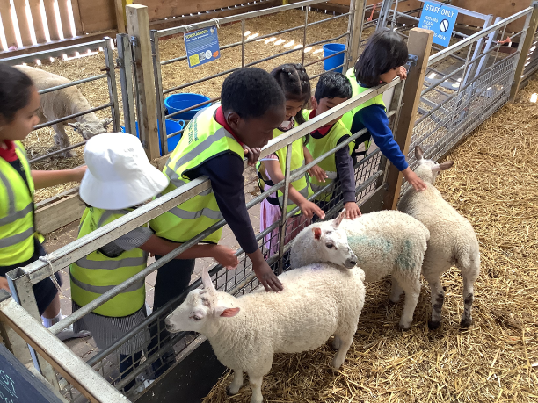

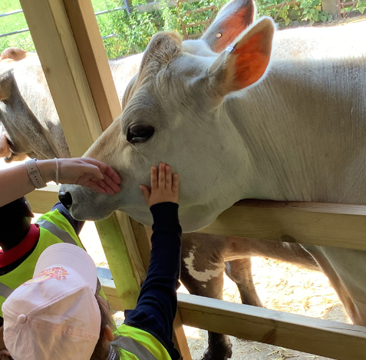
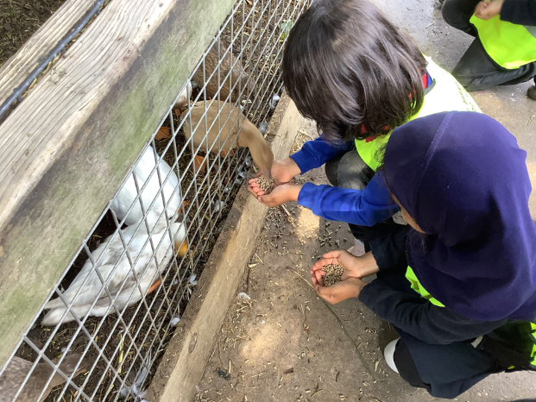
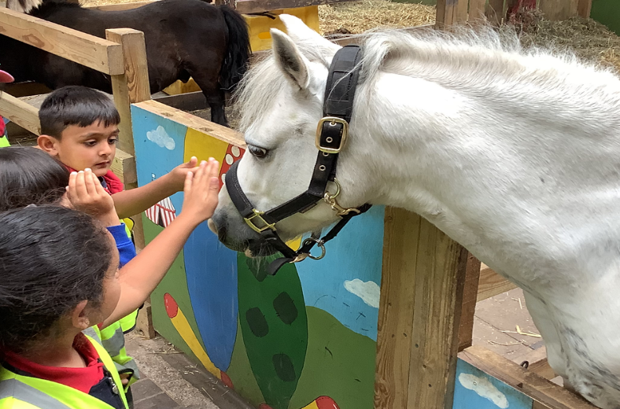
Reception Trip to Ash End Farm
On 16th and 17th June reception visited Ash End farm. The classes were guided round the farm where they saw lots of different animals such as pigs, sheep, horses, cows and even a tortoise! Everyone enjoyed learning about the animals and even had the opportunity to feed some of the animals. Each child was given an egg to take home.

Slide 7
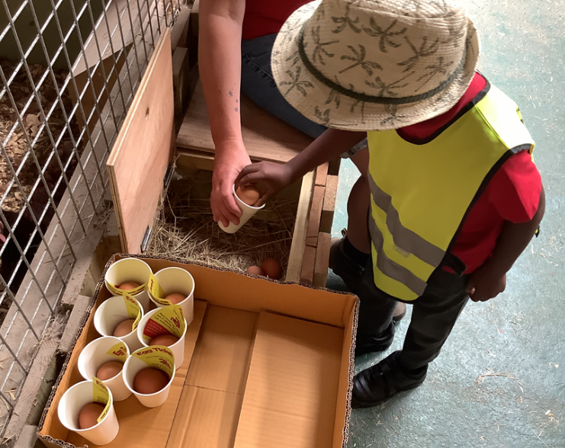
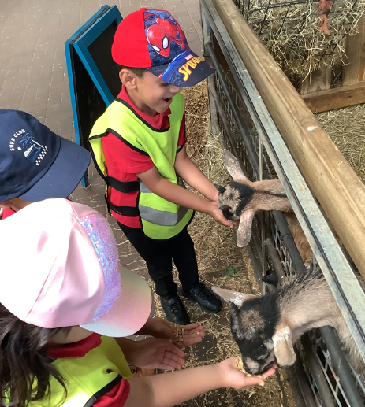
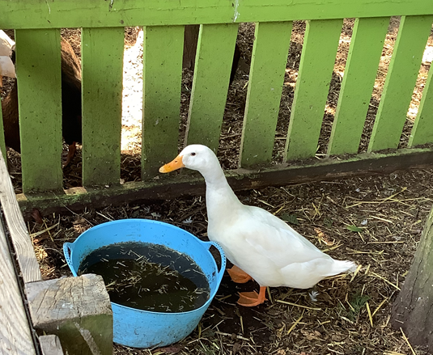
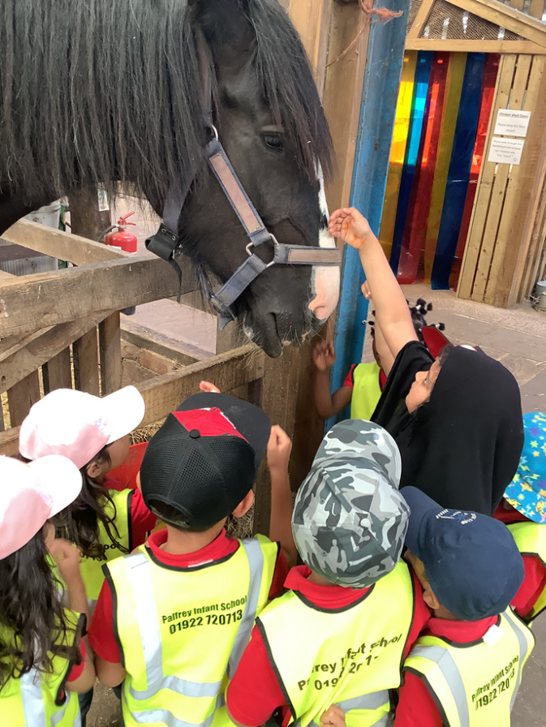
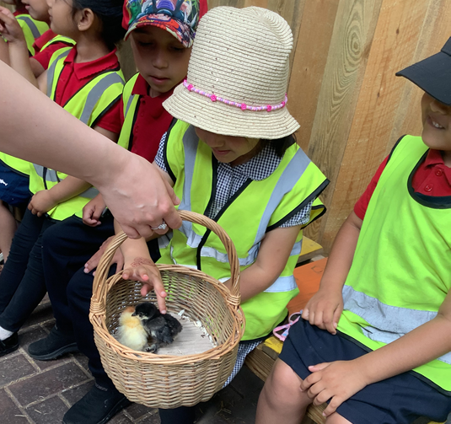
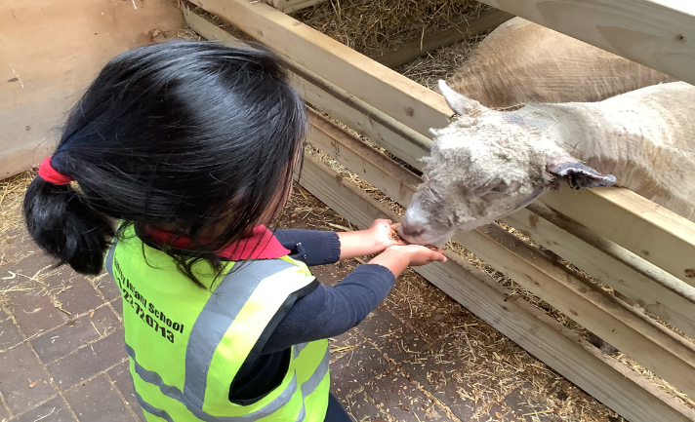







Slide 8

We are a NUT FREE School
Palfrey Infant School is a NUT FREE school.
We aim to protect children who have allergies to nuts yet also help them, as they grow up, to take responsibility as to what foods they can eat and to be aware of where they may be put at risk.
Please refrain from bringing in any types of NUTS as some of our children and staff have NUT allergies.
If you have any issues please speak to our office staff.

Slide 9

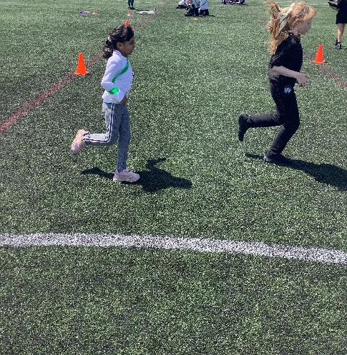
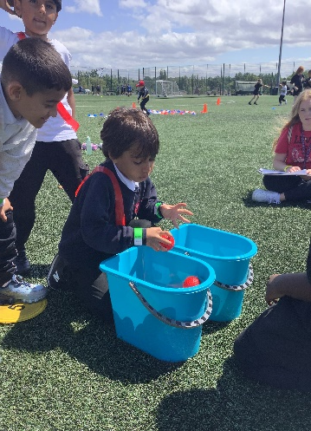
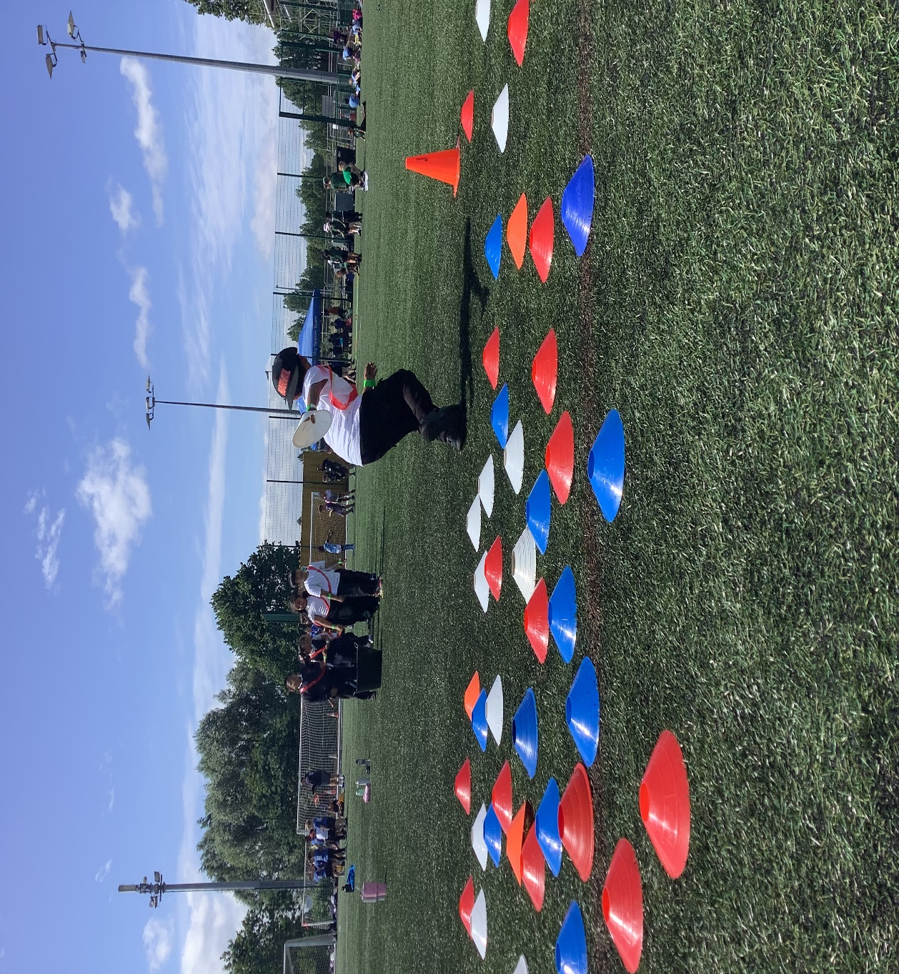
Walsall School Games
Inclusion Festival 2025
On Thursday 26th June, another group of students from year 2 visited the University of Wolverhampton to take part in the final of the Walsall school games inclusion festival.
They had the opportunity to take part in a variety of exciting activities and try new sports!

Slide 10






Nursery and Reception Stay and Play sessions.
Reception will be inviting parents to work with their child in class, focusing on reading, writing and maths. The final session will be on Tuesday 1st July 2025 at 2-3pm
Please add the following dates to your diaries:
• Wednesday 2nd July 2025— Transition to Reception Stay and Play (only for reception students starting in September)
• Wednesday 16th July 2025—Graduation Picnic! Parents are invited to attend. More details to follow shortly!

Slide 11













Key Dates
July
2nd July—School Move up Day
3rd July—Year 1 trip to Walsall Football Club
4th July—Year 1 trip to Walsall Football Club
14th July– Attendance Pizza Party
15th July—School Sports Day
16th July– Nursery Graduation picnic
17th July– Teddy Bears Picnic themed lunch
21st July—Under the sea themed lunch! School closes at 1pm for the Summer Term Holiday
Dates for your Diary

Slide 12

Our Golden Rules
BE KIND
BE SAFE
BE READY TO LEARN

Slide 13
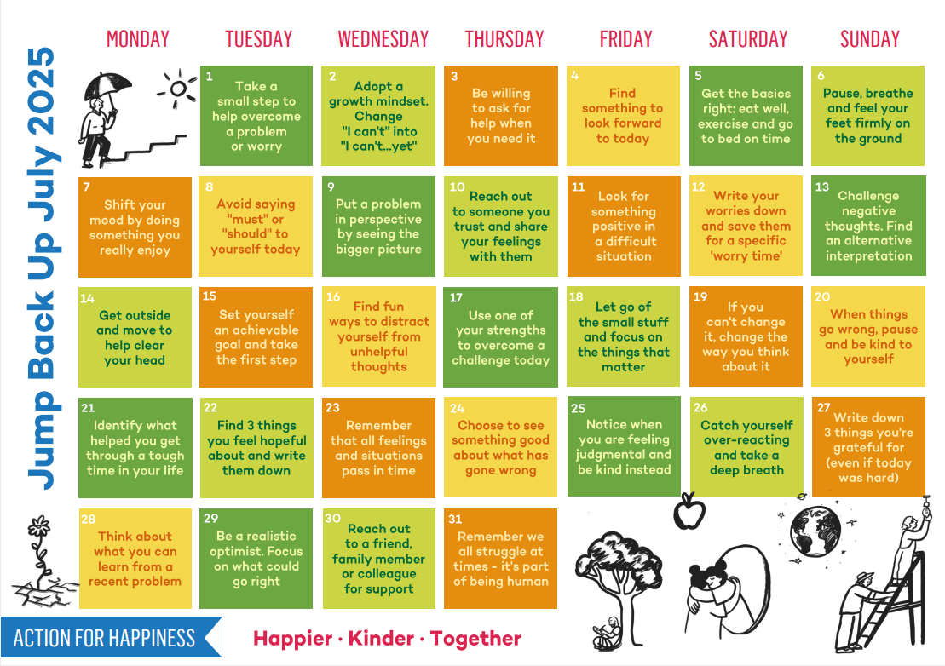
July 2025
Named after famed Roman Emperor Julius Caesar by decision of the Roman Senate in 44 BC, this month was originally the fifth month of the old calendar and because of this it was previously known as Quintilis, meaning fifth.

